Slide 1


Slide 2



MINISTRY OF HEALTH
Panama with health and wellness
General Directorate of Health
Department of Clinical Laboratory Regulation
Monday, August 26, 2024

Slide 3

RTCQI implementation and expansion

Slide 4
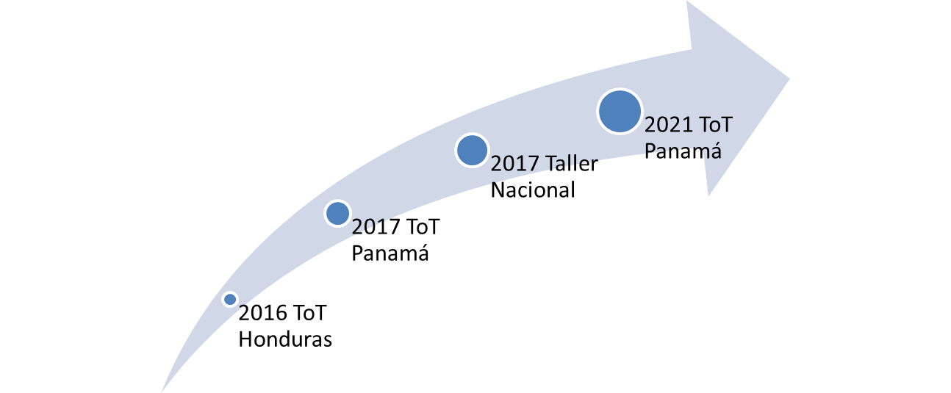

Slide 5
Baselines
ToT
National Workshop
improvement plans
1st follow-up evaluation
2nd follow-up evaluation
Certification of services
2 months
1 month
6 months
1 month
12 months
1 month
Notes:
Collate baseline evaluations first with SPI-RT list

Slide 6
Policy commitment
Policy 3 Achieve universal access to health and universal health coverage with equity, efficiency and quality.
L.A.3.3.7. Implementation, follow-up, surveillance and control of the national HIV/AIDS monitoring and evaluation plan with emphasis on collaborative TB-HIV activities.

Slide 7
Work Plan
Expanding access, improving the quality of HIV testing services and strengthening the continuum of care.
Objective:
Increase access to and improve the quality of technologies for HIV diagnosis and monitoring.
Specific Objectives:
Ensure delivery of quality HIV test results by performing tests accurately and reliably.
Ensure that HIV testing in health centers is carried out correctly, reliably and responsibly by the professional.

Slide 8
Human resources development
HIV WORKSHOP TRAINERS
Quantity | Region | Quantity | Region
3 | Bocas del Toro | 2 | Darien
4 | Ngäbe Bugle | 2 | Panama East
12 | Chiriqui | 1 | Panama West
3 | Cocle | 1 | Panama North
3 | Colón | 1 | Guna Yala
4 | Panama Metro | 6 | ICGES
1 | Herrera | 2 | San Miguelito
4 | Veraguas | 2 | Los Santos
Total 51
Trainers
ToT 4 Workshops
National Workshops 15
Recertificates
45
Notes:
I only have the numbers of HR trained, the number of workshops I do not have at the regional level.

Slide 9
Human resources development
Implementers (Testing personnel)
  Approximately 111 people were certified through the training parameters

Slide 10
Increasing the Proficiency testing (PT) program
Dry tube specimen (DTS) panel production
  Chiriquí (Coclé, Veraguas, Los Santos, Herrera, Comarca Ngäbe Bugle and Bocas del Toro)
  ICGES (Countrywide - 100)

Slide 11
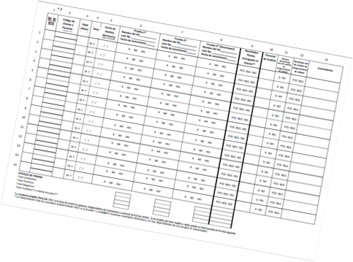
Expansion of standardized HIV testing and counseling registry
Third version of the book
of record
  Data by population
  key and general.

Slide 12
Batch testing and post-marketing surveillance.
This activity has been implemented by National Directorate of Medical Devices, and applies to all medical device, including in vitro diagnostic tests

Slide 13
Organization
Health Regions
Health facilities - local
Prepare your workshops.
Carry out supervisions of public and private laboratories.
Implement SPI - RT public and private laboratories.
Prepare MST panels
Perform the test according to the procedures.
Report problems with the devices used.
Participate in training sessions.

Slide 14
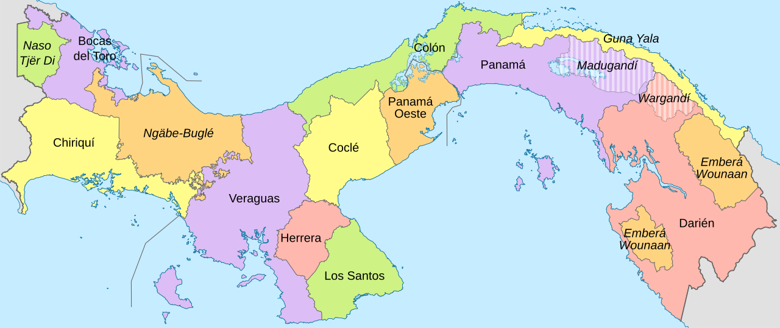
Certified laboratories
Chiriqui - 15
Ngäbe Bugle - 2
Veraguas - 5
Panama Oeste- 9
San Miguelito - 2

Slide 15
Key considerations
Clinical Laboratories
  Audiences
    150 Minsa
    53 Social Security Fund
Private laboratories
  108 laboratories (approximate)
Other professionals who are not laboratorians and community collaborators.
  40 professionals
  50 Community members

Slide 16
Reports
Clinical Laboratories
  Audiences
    79 Minsa
Private laboratories
  10 laboratories
Other professionals and community.
  5 health professionals.

Slide 17
Lessons Learned
Need for Trainers in each of the 15 Health Regions.
Periodic monitoring is vital.
Implementation of a national and regional continuing education program.
The financing must be self-sustaining for the country.
Leadership is essential for the program to be implemented and continue.
Each political group must be involved in quality issues.
Follow-up measurements are a tool that has motivated several laboratories to improve and pursue their points to achieve level 4.
One of the things we improved were the supervisions. At the beginning we organized a group at the Panama City level, then we decided to do it at the regional level for better management of the sites and people at the regional and local level.
Follow-up of non-clinical laboratory professionals and community collaborators is done at the time of resupplying tests, without delivery of reports there is no delivery of tests. This is the way we have found to keep track.

Slide 18


